Slide 1
Object Oriented Programming—C++ Lecture 12 Final Review
Qijun Zhao
College of Computer Science
Sichuan University
Spring 2023

Slide 2
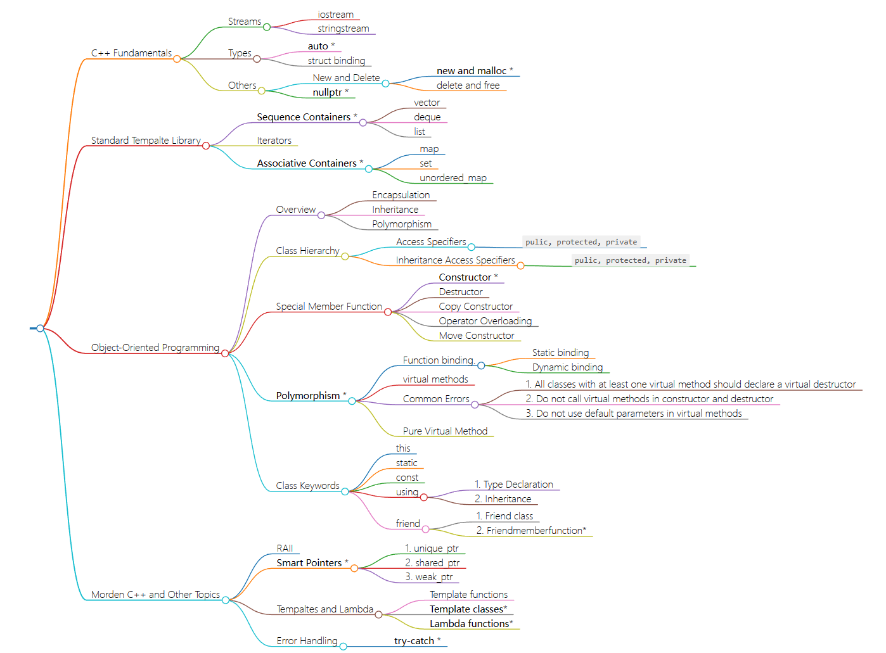

Slide 3
1. C++ Fundamentals and STL
1.1 Stream
1.2 Types
1.3 STL
1.4 Others

Slide 4
1.1 Stream
Stream: an abstraction for input/output.
Streams convert between data and the string representation of data.
<iostream> | 该文件定义了 cin、cout、cerr 和 clog 对象，分别对应于标准输入流、标准输出流、非缓冲标准错误流和缓冲标准错误流。
<fstream> | 该文件为用户控制的文件处理声明服务。

Slide 5
Two ways to classify streams
By Direction:
By Source or Destination:
Input streams: Used for reading data (ex. ‘std::istream’,
‘std::cin’)
Output streams: Used for writing data (ex. ‘std::ostream’, ‘std::cout’)
Input/Output streams: Used for both reading and writing data (ex. ‘std::iostream’, ‘std::stringstream’)
Console streams: Read/write to console (ex. ‘std::cout’, ‘std::cin’)
File streams: Read/write to files
(ex. ‘std::fstream’, ‘std::ifstream’,
‘std::ofstream’)
String streams: Read/write to strings (ex. ‘std::stringstream’,
‘std::istringstream’,
‘std::ostringstream’)

Slide 6
1.2 Types
auto: Keyword used in lieu of type when declaring a variable, tells the compiler to deduce the type.
📝 auto does not mean that the variable doesn’t have a type. It means that the type is deduced by the compiler.

Slide 7
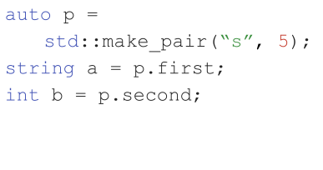
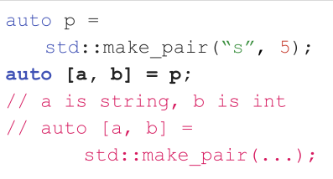
Structured Binding (结构化绑定)
Structured binding lets you initialize directly from the contents of a struct
Before
After
📝 This works for regular structs, too. No nested structured binding.

Slide 8
1.3 STL
C++ STL（标准模板库）是一套功能强大的 C++ 模板类，提供了通用的模板类和函数，这些模板类和函数可以实现多种流行和常用的算法和数据结构，如向量、链表、队列、栈。
容器（Containers） | 容器是用来管理某一类对象的集合。C++ 提供了各种不同类型的容器，比如 deque、list、vector、map 等。
算法（Algorithms） | 算法作用于容器。它们提供了执行各种操作的方式，包括对容器内容执行初始化、排序、搜索和转换等操作。
迭代器（Iterators） | 迭代器用于遍历对象集合的元素。这些集合可能是容器，也可能是容器的子集。

Slide 9
STL containers:
Sequence:
● Containers that can be accessed sequentially
● Anything with an inherent order goes here!
● vector, queue, deque, list
Associative:
● Containers that don’t necessarily have a sequential order
● More easily searched
● map, set, unordered_map

Slide 10
In the STL
All containers implement iterators, but they’re not all the same!
● Each container has its own iterator, which can have different behavior.
● All iterators implement a few shared operations:
○ Initializing iter = s.begin();
○ Incrementing ++iter;
○ Dereferencing *iter;
○ Comparing iter != s.end();
○ Copying new_iter = iter;

Slide 11
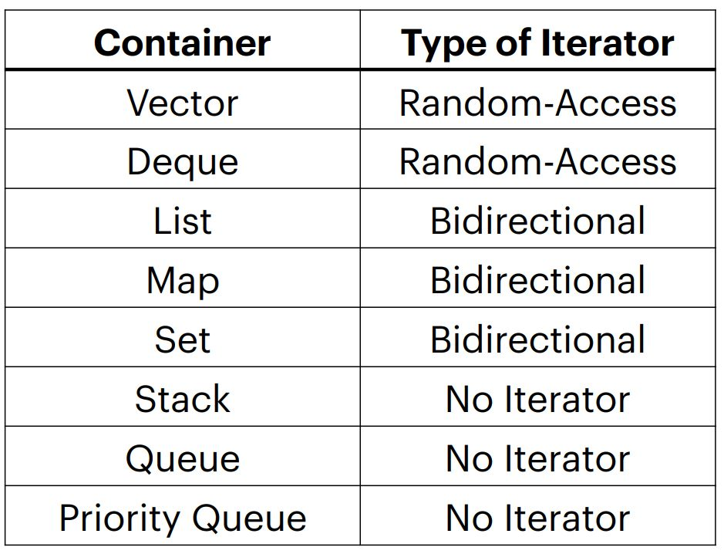
Categorizing STL iterators
Vectors and deques have the most powerful iterators!
● Creating your own containers means creating their iterators as well.
● You can access elements in stacks and queues one-by-one, but you have to change the container to do so!
● Iteration with iterators is const

Slide 12
1.4 Others
New and Delete
malloc与free是C++/C语言的标准库函数，new/delete是C++的运算符。它们都可用于申请动态内存和释放内存。
对于非内部数据类型的对象而言，光用malloc/free无法满足动态对象的要求。对象在创建的同时要自动执行构造函数，对象在消亡之前要自动执行析构函数。由于malloc/free是库函数而不是运算符，不在编译器控制权限之内，不能够把执行构造函数和析构函数的任务强加于malloc/free。
因此C++语言需要⼀个能完成动态内存分配和初始化工作的运算符new，以及⼀个能完成清理与释放内存工作的运算符delete。 注意new/delete不是库函数。 C++程序经常要调用C函数，而C程序只能用malloc/free管理动态内存。
new可以认为是malloc加构造函数的执行。new出来的指针是直接带类型信息的，而malloc返回的都是void指针。

Slide 13
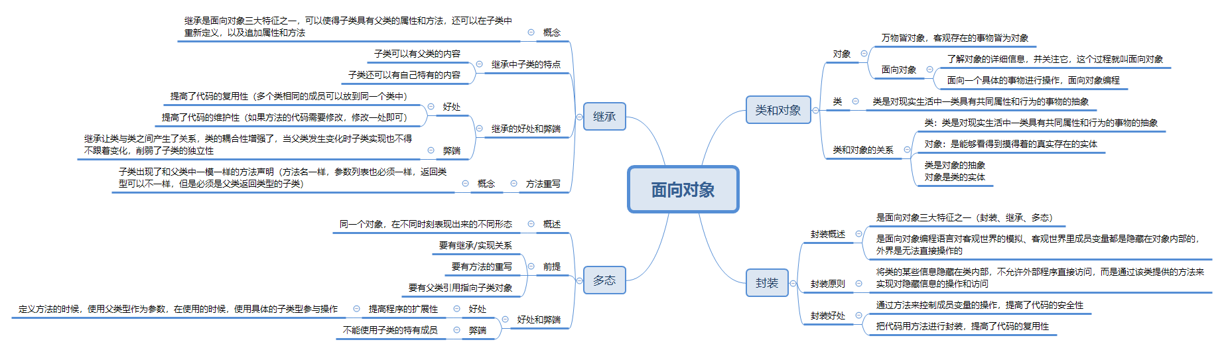

Slide 14
2.OOP
2.1 RAII and Smart Pointers
2.2 Class Hierarchy
2.2.1 Access Specifiers
2.2.2 Inheritance Access Specifiers
2.3 Class Special Member Function
2.4 Polymorphism
2.5 Class Keywords
2.6 Templates and Lambda

Slide 15
2.1 RAII and Smart Pointers
RAII Idiom - Resource Acquisition is Initialization
Holding a resource is a class invariant, and is tied to object lifetime
RAII Idiom consists in three steps:
• Encapsulate a resource into a class (constructor)
• Use the resource via a local instance of the class
• The resource is automatically releases when the object gets out of scope
(destructor)
Implication 1: C++ programming language does not require the garbage collector!!
Implication 2: The programmer has the responsibility to manage the resources.

Slide 16
Smart Pointers
- 智能指针：
- 管理动态对象。
- 行为类似常规指针。
- 负责自动释放所指向的对象。
- 智能指针也是模板。
C++11 引入了 3 个智能指针类型：
std::unique_ptr<T> ：独占资源所有权的指针。
std::shared_ptr<T> ：共享资源所有权的指针。
std::weak_ptr<T> ：共享资源的观察者，需要和 std::shared_ptr 一起使用，不影响资源的生命周期。

Slide 17
2.2 Class Hierarchy
Child/Derived Class or Subclass
A new class that inheriting variables and functions from another class is called a derived or child class
Parent/Base Class
The closest class providing variables and functions of a derived class is called parent or base class
Extending a base class refers to creating a new class which retains characteristics of the base class and on top it can add (and never remove) its own members

Slide 18
2.2.1 Access specifiers (访问说明符)
The access specifiers define the visibility of inherited members of the subsequent base
class. The keywords public , private , and protected specify the sections of visibility
The goal of the access specifiers is to prevent a direct access to the internal representation of the class for avoiding wrong usage and potential inconsistency (access control)
• public: No restriction (function members, derived classes, outside the class)
• protected: Function members and derived classes access
• private: Function members only access (internal)
struct has default public members
class has default private members

Slide 19
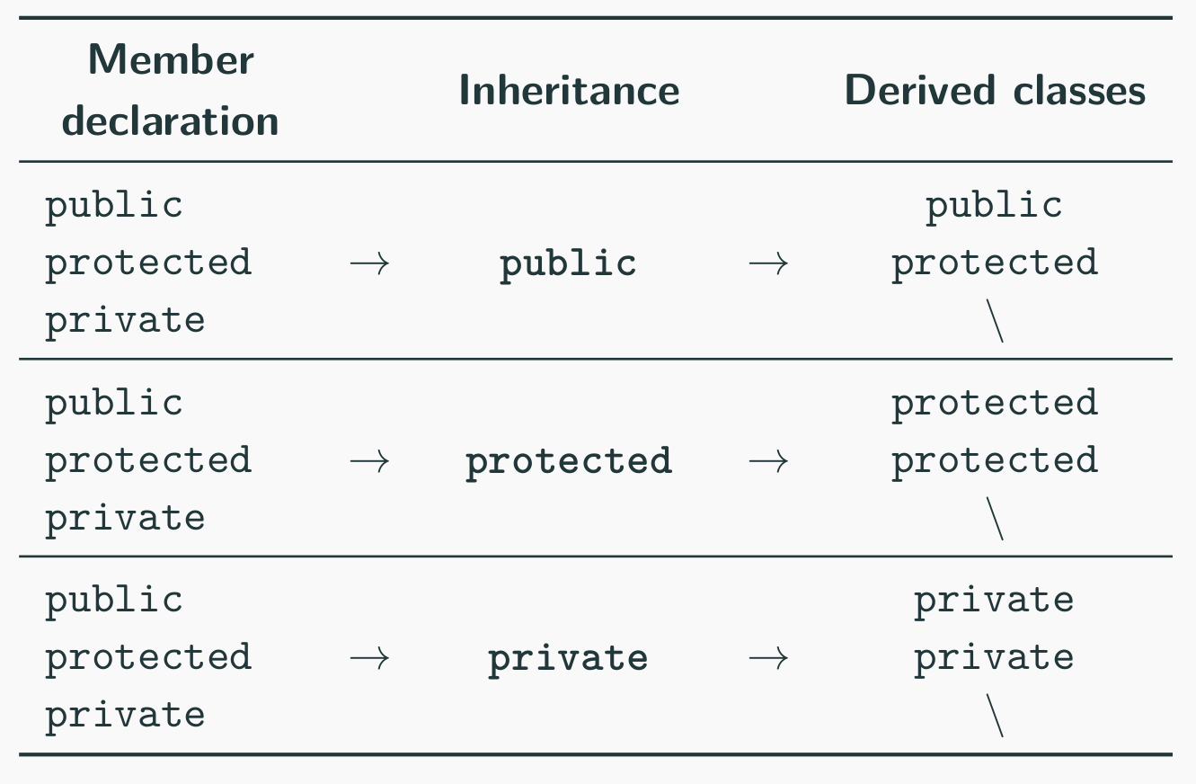
2.2.2 Inheritance Access Specifiers
The access specifiers are also used for defining how the visibility is propagated from the base class to a specific derived class in the inheritance

Slide 20
2.3 Class Special Member Function
Class Constructor and Destructor
Constructor [ctor]
A constructor is a special member function of a class that is executed when a new instance of that class is created Goals: initialization and resource acquisition Syntax: T(...) same named of the class and no return type
• A constructor is supposed to initialize all data members
• We can define multiple constructors with different signatures
• Any constructor can be constexpr

Slide 21
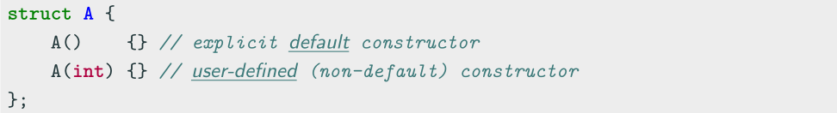
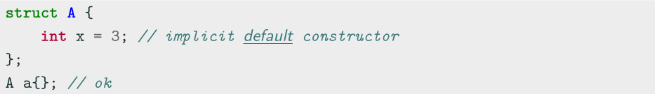
Default Constructor (默认构造函数)
Default Constructor
The default constructor T() is a constructor with no argument
Every class has always either an implicit or explicit default constructor
• An implicit default constructor is constexpr

Slide 22
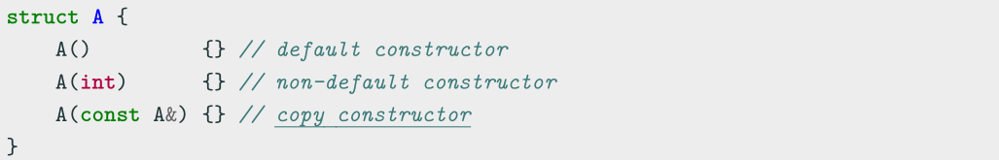
Copy Constructor (拷贝构造函数)
Copy Constructor
A copy constructor T(const T&) creates a new object as a deep copy of an existing object
Every class always defines an implicit or explicit copy constructor
Even the copy constructor implicitly calls the default Base class constructor
Even the copy constructor is considered a non-default constructor

Slide 23
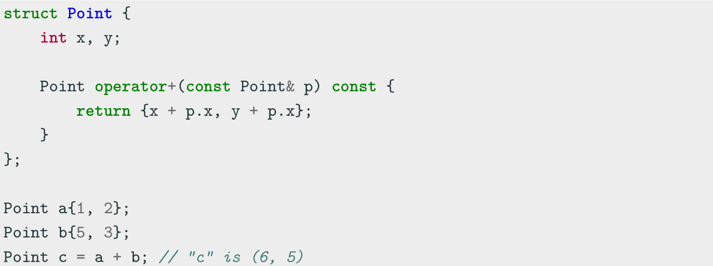
Operator Overloading (运算符重载)
Operator Overloading
Operator overloading is a special case of polymorphism in which some operators are treated as polymorphic functions and have different behaviors depending on the type of its arguments

Slide 24
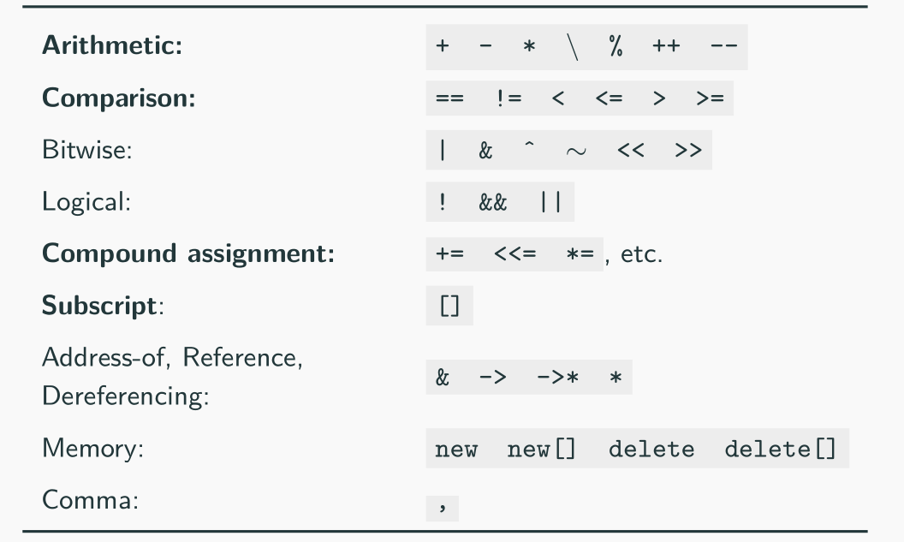
Operator Overloading
Categories not in bold are rarely used in practice
Operators which cannot be overloaded: ? . .* :: sizeof typeof

Slide 25
2.4 Polymorphism (多态)
Polymorphism
In Object-Oriented Programming (OOP), polymorphism (meaning “having multipleforms”) is the capability of an object of mutating its behavior in accordance with the specific usage context
• At run-time, objects of a base class behaves as objects of a derived class
• A Base class may define and implement polymorphic methods, and derived classes can override them, which means they provide their own implementations, invoked at run-time depending on the context

Slide 26
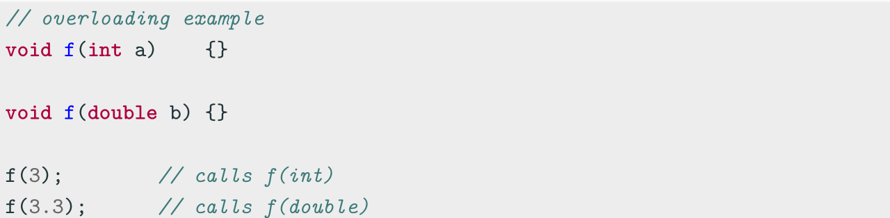
Polymorphism vs. Overloading
Overloading is a form of static polymorphism (compile-time polymorphism)
In C++, the term polymorphic is strongly associated with dynamic polymorphism
(overriding)

Slide 27
Function Binding (函数绑定)
Connecting the function call to the function body is called Binding
• In Early Binding or Static Binding or Compile-time Binding, the compiler identifies
the type of object at compile-time
- the program can jump directly to the function address
• In Late Binding or Dynamic Binding or Run-time binding, the run-time identifies
the type of object at execution-time and then matches the function call with the
correct function definition
- the program has to read the address held in the pointer and then jump to that
address (less efficient since it involves an extra level of indirection)
C++ achieves late binding by declaring a virtual function

Slide 28
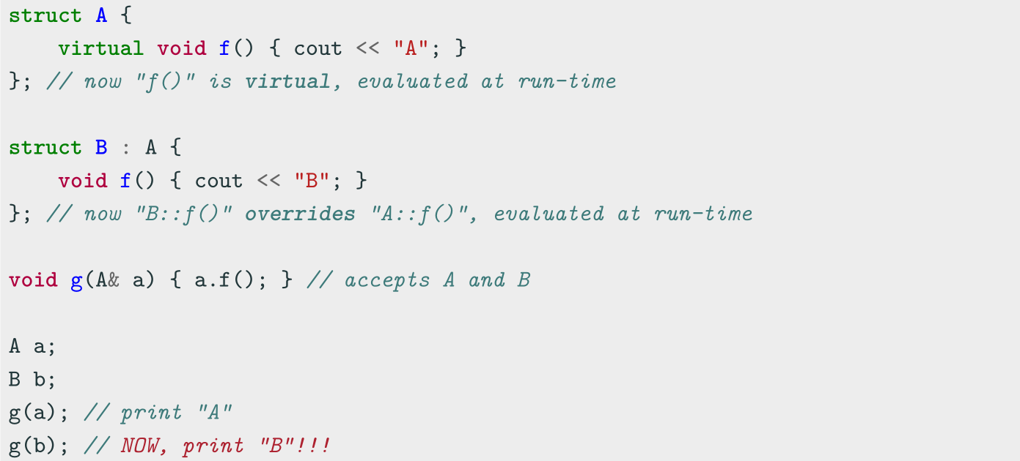
Polymorphism - virtual method (虚方法)
The virtual keyword is not necessary in derived classes, but it improves readability and
clearly advertises the fact to the user that the function is virtual

Slide 29
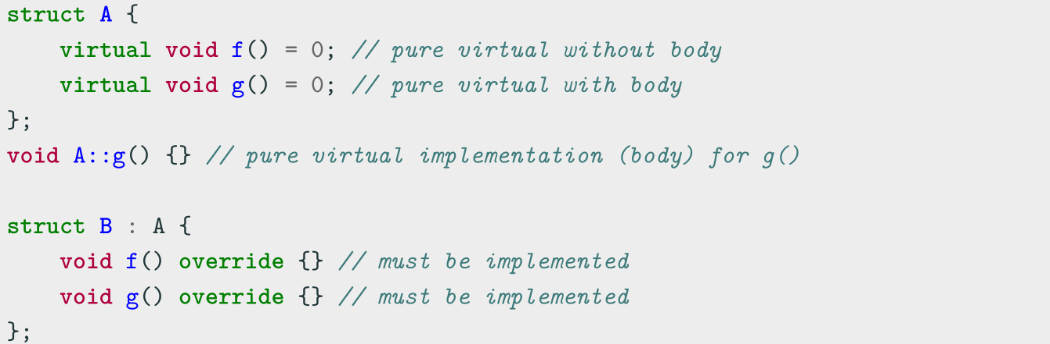
Pure Virtual Method (纯虚方法)
Pure Virtual Method
A pure virtual method is a function that must be implemented in derived classes (concrete implementation)
Pure virtual functions can have or not have a body

Slide 30
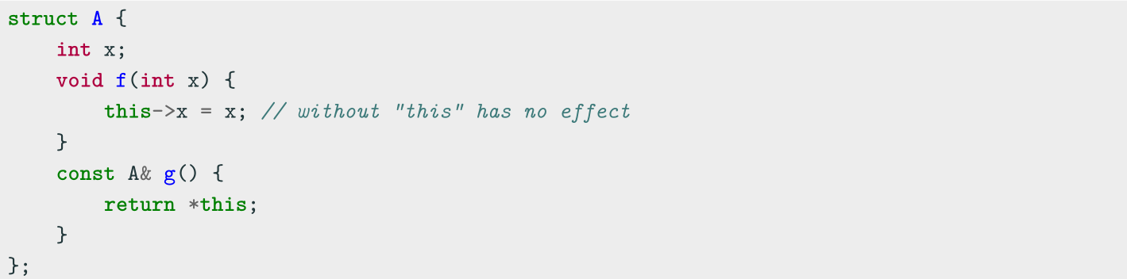
2.5 Class Keywords (类关键字)
this
Every object has access to its own address through the const pointer this
Explicit usage is not mandatory (and not suggested)
this is necessary when:
• The name of a local variable is equal to some member name
• Return reference to the calling object

Slide 31
Class Keywords——static
static (静态)
The keyword static declares members (fields or methods) that are not bound to class instances. A static member is shared by all objects of the class
• A static member function can only access static class members
• A non- static member function can access static class members
• Non-const static data members cannot be directly initialized inline ...before C++17

Slide 32
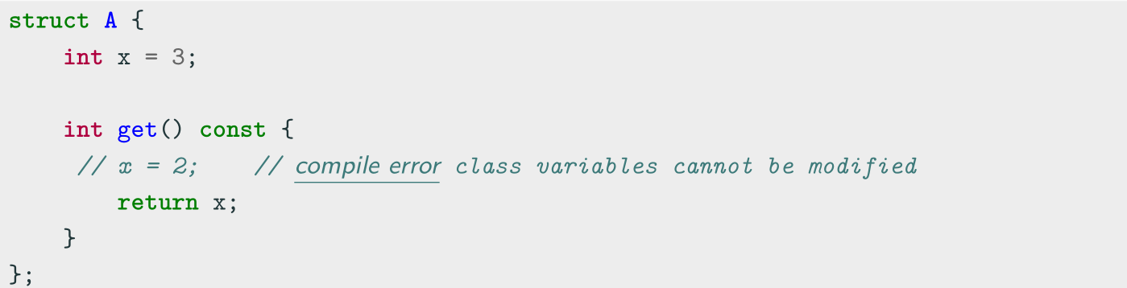
Class Keywords——const
Const member functions (常量成员函数)
Const member functions (inspectors or observer) are functions marked with const that are not allowed to change the object state
Member functions without a const suffix are called non-const member functions or mutators. The compiler prevents from inadvertently mutating/changing the data members of observer functions

Slide 33
Class Keywords——friend (友元)
friend Class
A friend class can access the private and protected members of the class in which it is declared as a friend
Friendship properties:
• Not Symmetric: if class A is a friend of class B, class B is not automatically a
friend of class A
• Not Transitive: if class A is a friend of class B, and class B is a friend of class C,
class A is not automatically a friend of class C
• Not Inherited: if class Base is a friend of class X, subclass Derived is not
automatically a friend of class X; and if class X is a friend of class Base, class X is
not automatically a friend of subclass Derived

Slide 34
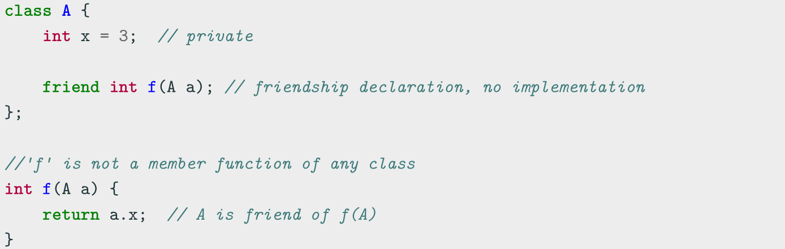
Class Keywords——friend
friend Method
A non-member function can access the private and protected members of a class if it is declared a friend of that class
friend methods are commonly used for implementing the stream operator operator<<

Slide 35
2.6 Templates and Lambda
Template Class: A class that is parametrized over some number of types. A class that is comprised of member variables of a general type/types.

Slide 36
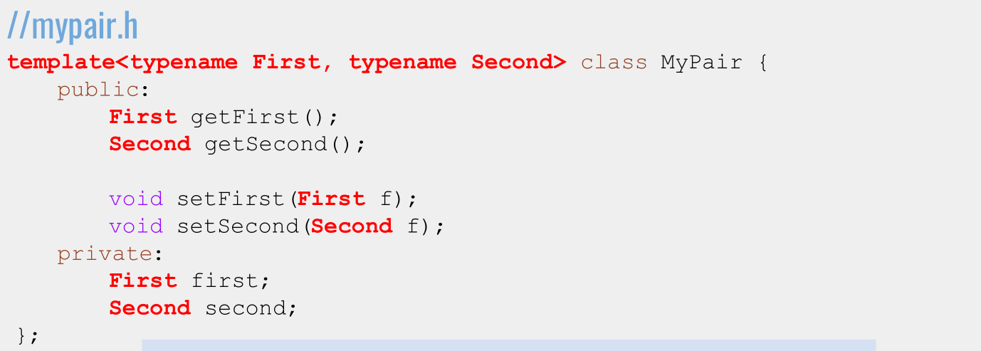

Writing a Template Class: Syntax

Slide 37
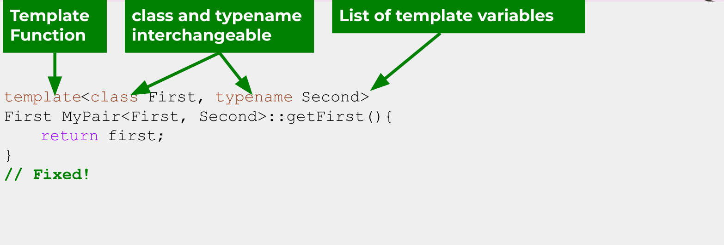
Implementing a Template Class: Syntax

Slide 38
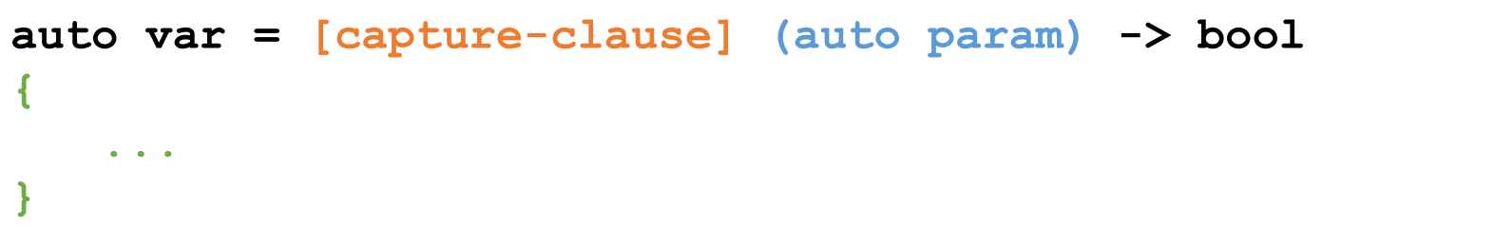
Lambdas Function
Lambdas are inline, anonymous functions that can know about functions declared in their same scope!
Outside parameters
go here
Specifies that
Type is generic
Function body
goes here!

Slide 39
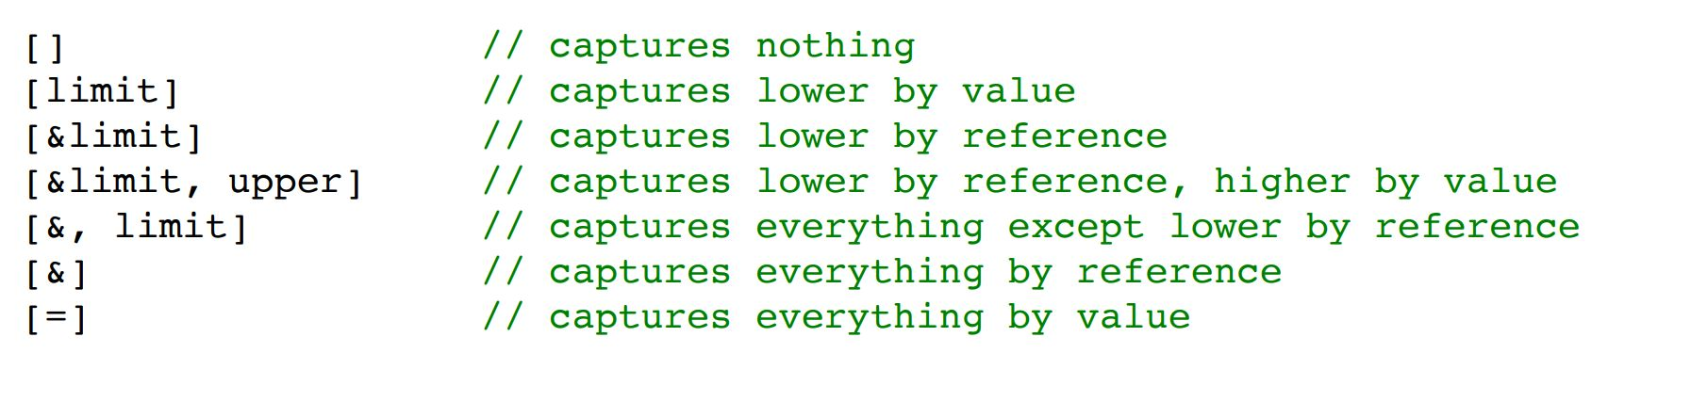
Capture Clauses
You can capture any outside variable, both by reference and by value.
● Use just the = symbol to capture everything by value,
and just the & symbol to capture everything by reference

Slide 40
Using Lambdas
Lambdas are pretty computationally cheap and a great tool!
● Use a lambda when you need a short function or to access local variables in your function.
● If you need more logic or overloading, use function pointers.

Slide 41
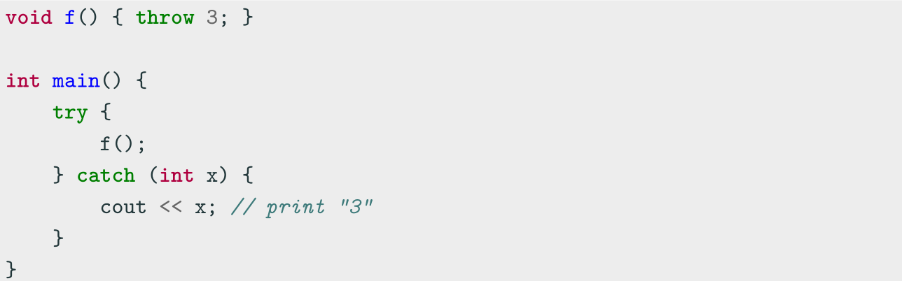
3. Advanced Topics
C++ Exception Basics
C++ provides three keywords for exception handling:
throw Throws an exception
try Code block containing potential throwing expressions
catch Code block for handling the exception

Slide 42
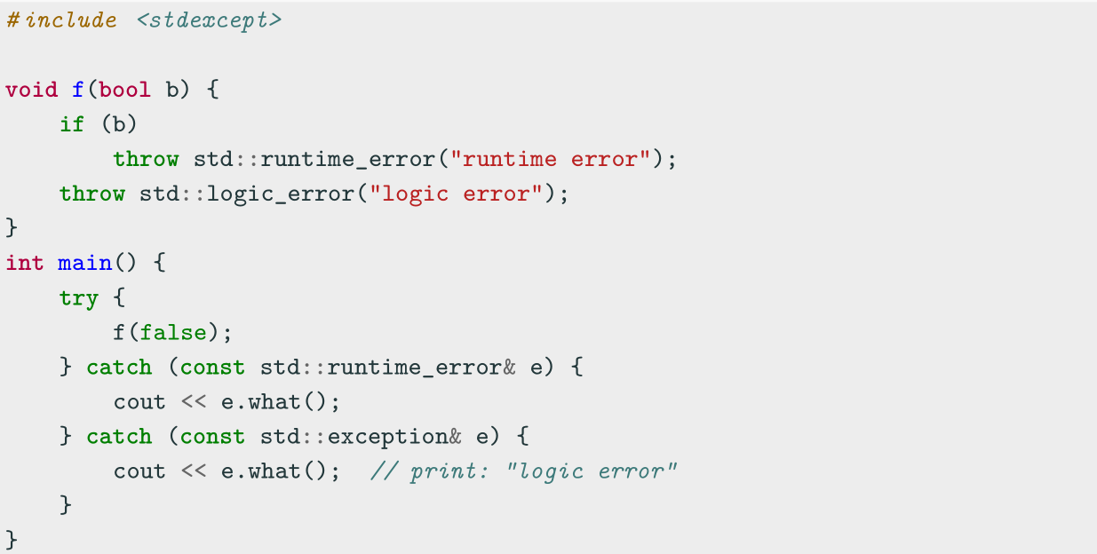
std Exceptions
throw can throw everything such as integers, pointers, objects, etc. The standard
way consists in using the std library exceptions <stdexcept>

Slide 43
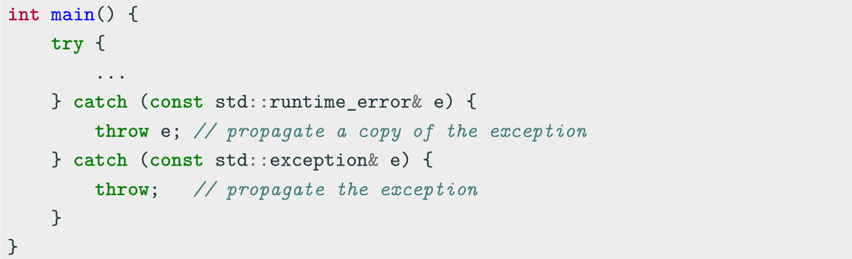
Exception Propagation
Exceptions are automatically propagated along the call stack. The user can also
control how they are propagated

Slide 44
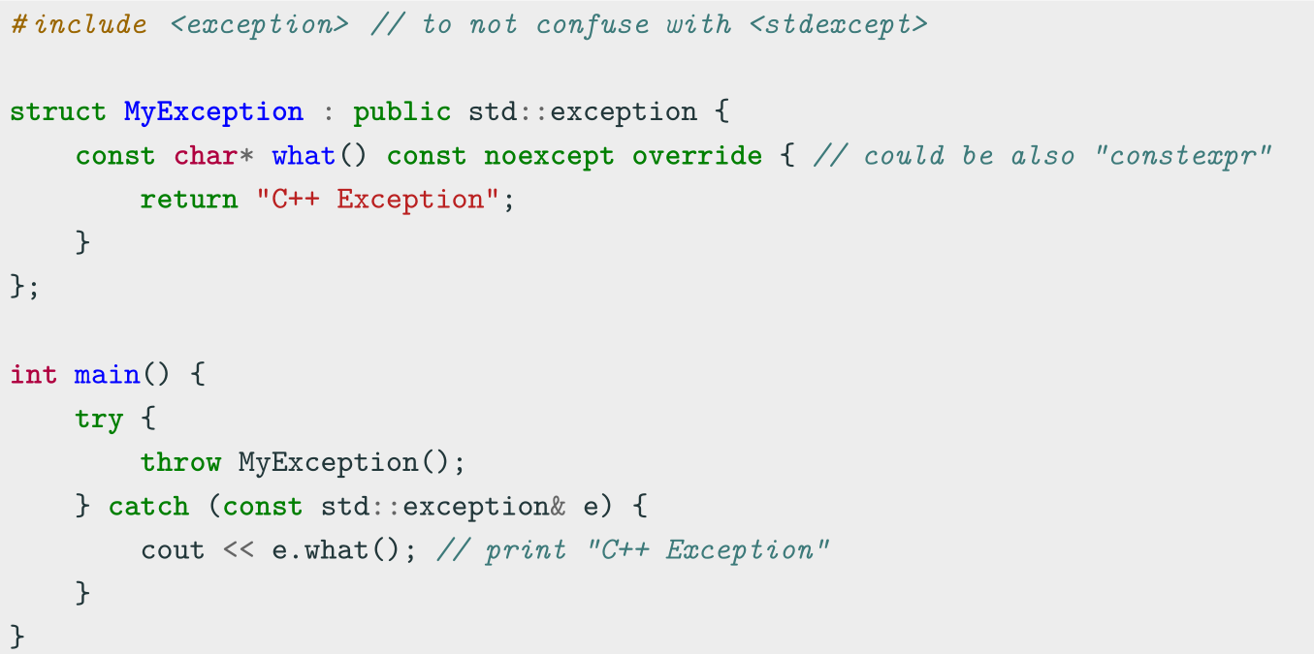
Defining Custom Exceptions

Slide 45
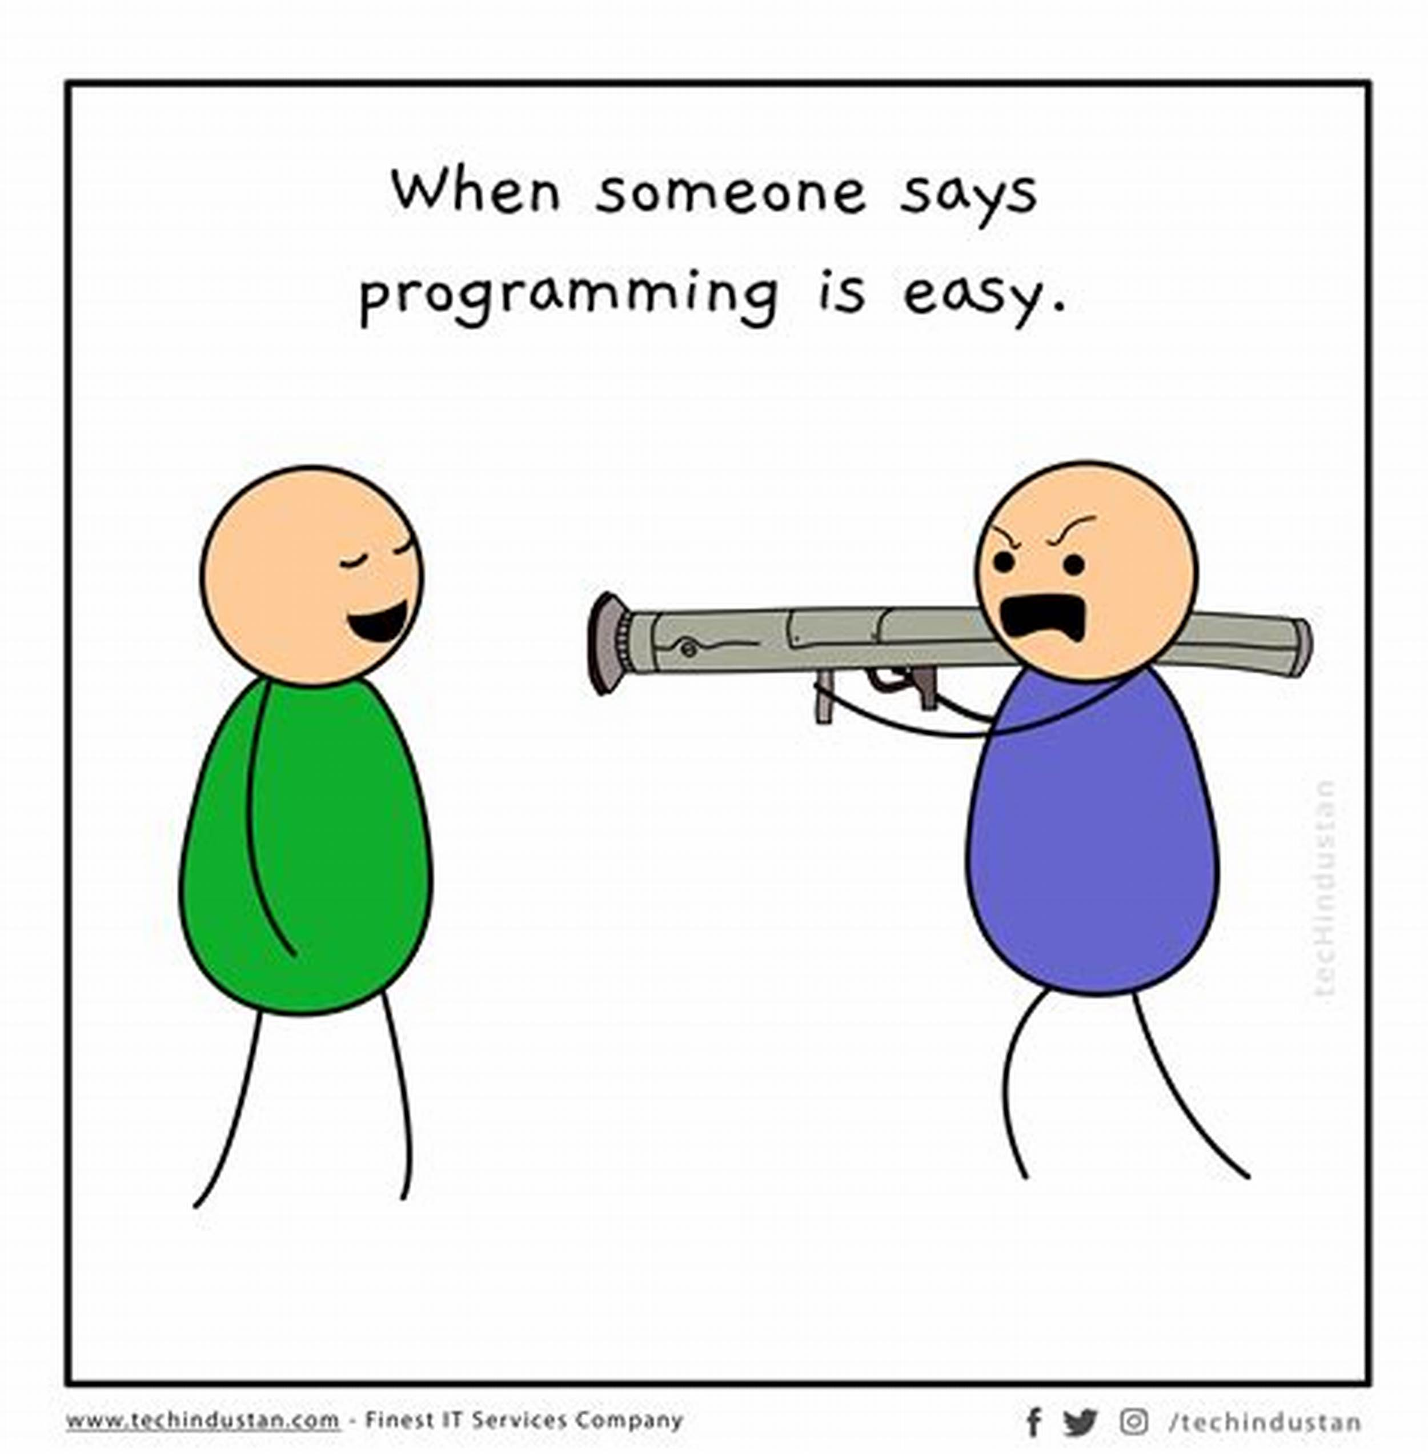
期末考试
时间：第17周星期二（6月13日）下午14:00—16:00
地点：江安综合楼B座B504
形式：闭卷（中文）
题型与分值：
单选题，10道、20分
填空题，5道、10分
程序阅读题，8道、40分
程序填空题，10小问，20分
Lambda函数设计题，2道，10分

Slide 46
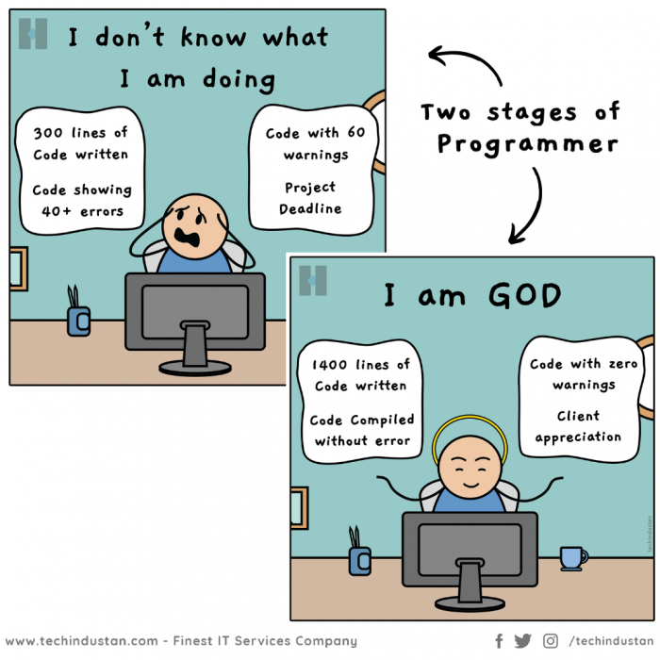
谢谢你们一学期的陪伴和共同进步，祝你们早日成为God Progammer!
https://syl.scu.edu.cn/info/1004/2708.htm
https://syl.scu.edu.cn/info/1004/2766.htm

Slide 47
Coding for love, Coding for the world
Qijun Zhao
qjzhao@scu.edu.cn

